Slide 1

HLS-1 (AI/ML Model To Predict Claims Fraud(Health Care))
Team – Mount India
Submitted by: - Amit Yadav
Anand Gupta
Prateek Kumar Singh

Slide 2
CONTENTS
INTRODUCTION
TYPES OF PAYER FRAUD
HEALTHCARE CLAAIMS DATASET
LABELS OF FRAUD
DATA PREPROCESSING
PATIENTS INFORMATION
FRAUD Vs NON-FRAUD
RESULTS
FEATURES UTILIZED
CONCLUSION

Slide 3
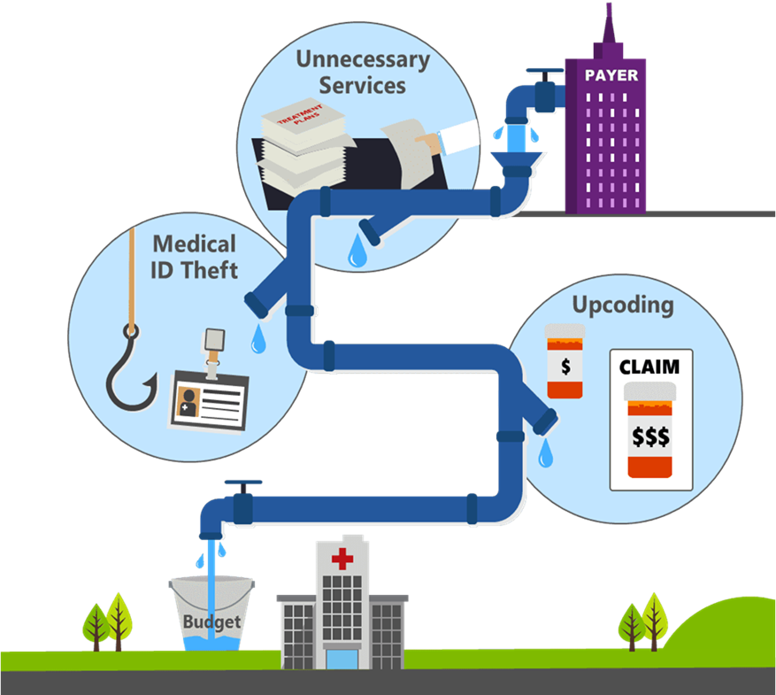
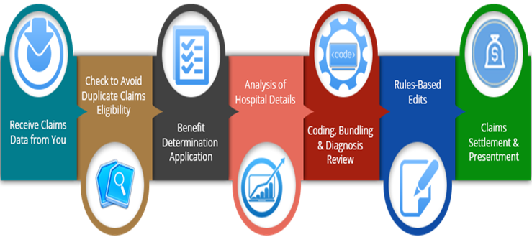
What is Payer-facing in healthcare
Payer-facing healthcare fraud refers to any deliberate and unlawful activity committed by healthcare providers or individuals to obtain payments or benefits from healthcare payers, such as insurance companies or government programs.
This type of fraud can take many forms, including billing for services that were not provided, upcoding or unbundling services to receive higher reimbursement, providing unnecessary medical services, and identity theft.
Payer-facing healthcare fraud can result in significant financial losses for payers, as well as compromised patient care and increased healthcare costs.
It is important for payers to have robust fraud detection systems in place to identify and prevent fraudulent activity.
How do they commit fraud?
Billing for care that they never rendered.
Submitting duplicate claims.
Falsifying claim/patient info.
Disguising non-covered services as covered services.
Using incorrect diagnosis/procedure codes.

Slide 4

Common types of healthcare paying fraud
Billing for services that were not provided: This occurs when a healthcare provider bills for medical services or equipment that were not actually provided to the patient.
Upcoding: This is when a healthcare provider bills for a higher level of service than was actually provided. For example, billing for a more expensive procedure or treatment than was actually given to the patient.
Unbundling: This is when a healthcare provider bills separately for services that should have been billed together as a package deal.
Double billing: This is when a healthcare provider bills both the patient and the insurance company for the same service.
Kickbacks: This is when a healthcare provider receives payment or other compensation for referring patients or recommending certain treatments or products.

Slide 5
HEALTHCARE CLAIMS DATASET
Beneficiary:
Info about patients for whom claims have been submitted
Inpatient:
Claim level data (with provider/doctor info) for the patients that have stayed at the hospital for the medical service.
Outpatient:
Claim level data (with provider/doctor info) for the patients that have stayed at the hospital for the medical service.
Inpatient
Outpatient
Beneficiary

Slide 6
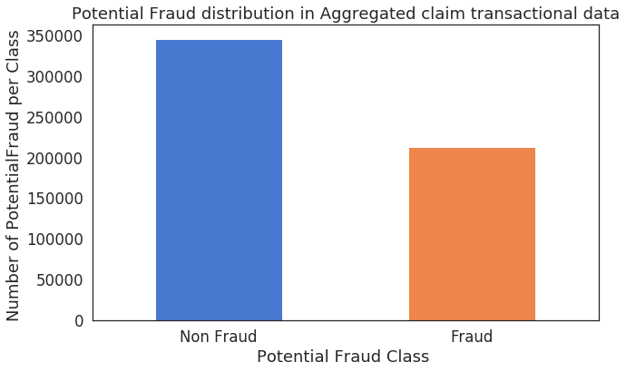
LABELS OF FRUAD
Fraud labels provided for Hospitals.
Fraud/Non-Fraud providers:
The resulting plot shows the distribution of potential fraud and non-fraud classes in the merged transactional data, with the y-axis representing the number of occurrences for each class..

Slide 7
DATA PREPROCESSING
Missing Data Imputed:
Beneficiary:
Inpatient:
Outpatient:
Label Encoding: All categorical features
New Feature Creation:
Deceased, Tot_Reimbursed_Amt, Hospital_Stay, Claim_Duration, Physician_Count, Claim_Count, Chr_Cond_Count, etc.
Dropped features:
With high null values, ones from which other features were created, etc.
Combined all datasets with fraud labels.
Data was robust-scaled:
Due to the inclusion of outliers
Two different sets were evaluated for each model:
Auto- Encoder for learning generative model
Different model types attempted:
Logistic Regression
Random Forest
Linear SVC

Slide 8
Model Improvement
Based on the above model performance ,there is a scope in improving model performance by :
1) Adding more fraud data to the training dataset help in predicting unseen fraudulent behavior time to time.
2) Ensembling methods with parameter tuning can improve performance of the models.
3) Vectorizing Medical codes(ICD 9 codes) with Count Vectorizer may add performance improvement.

Slide 9
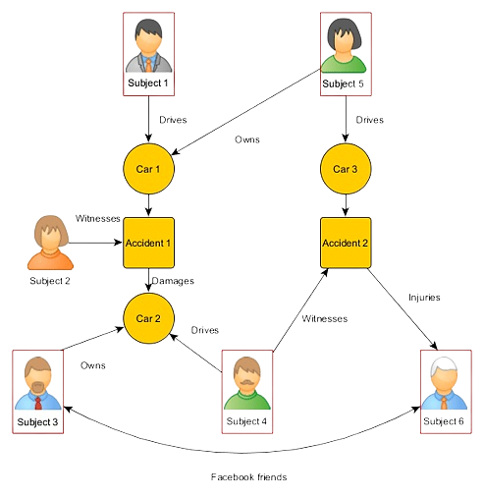

Use cases
Insurance company

Slide 10
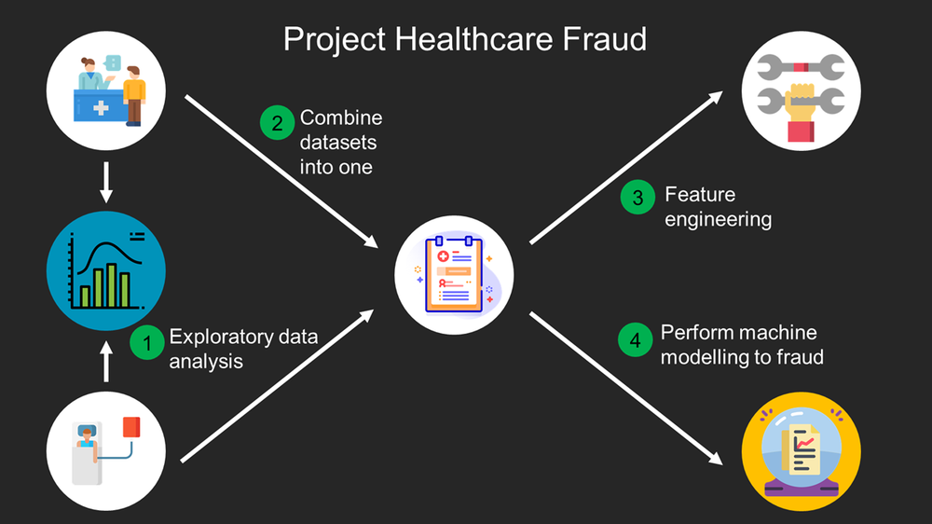

Slide 11



Market Potential
Businesses take measures to protect themselves from scammers. To make their anti-fraud strategy efficient, organizations must ensure they accept legitimate transactions only and provide instant user authentication. Once these operations are organized, you can achieve frictionless customer experience while minimizing the risk of fraud-related losses.
A fraud detection and prevention system is the core of any fraud risk management strategy. Teams choose software with functionality that works best for their workflow and business needs in general.
.

Slide 12
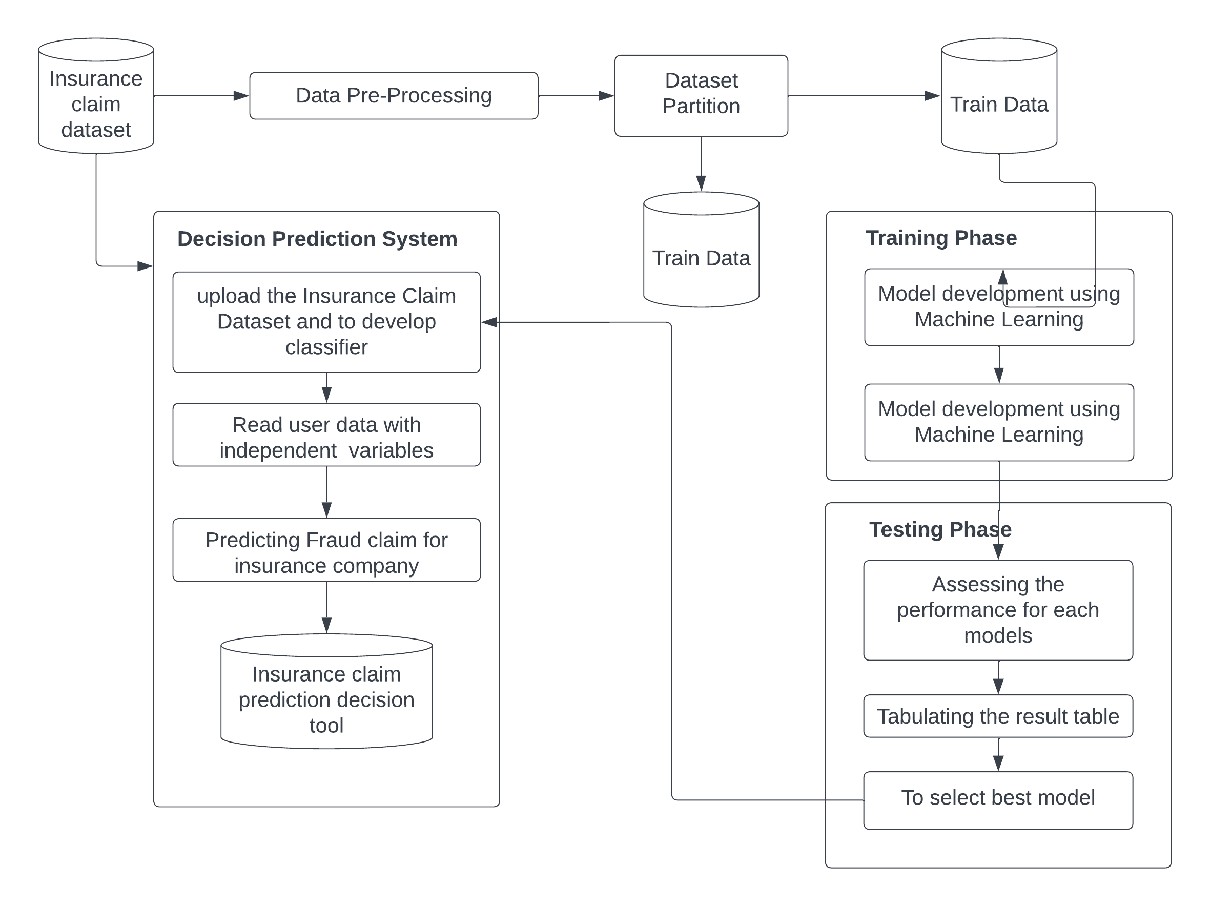
Data Model Architecture
Here the following Diagram shows the flow of data (raw format) to various processes the model does to vigorously train itself and be ready to use on the real world dataset of insurance companies.

Slide 13
Solution
Roadmap:
How we Hope to move Forward

Slide 14
Future Scope
&
Cross-Industry
application
Increasing the model's accuracy: The model's performance can be continuously improved by incorporating more data and refining the algorithms used.
Enhancing the model's capabilities: The model can be extended to detect other types of fraud or to incorporate additional data sources, such as social media data, to improve its accuracy.
Incorporating other related technologies: The model can be integrated with other related technologies such as blockchain, to enhance the security and transparency of the system.
Deploying the model in different domains: The model can be deployed in different domains such as e-commerce, banking and finance, healthcare, and insurance to detect fraud in those sectors.

Slide 15
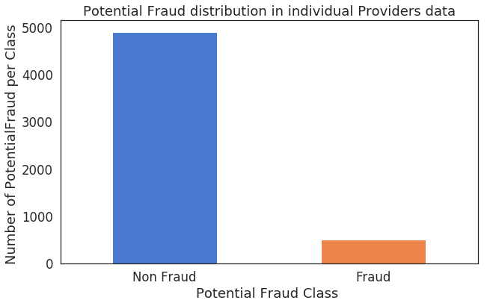
Before we proceed…
Basic information of patients
Most of the Beneficiaries that have Inpatient/Outpatient claims are alive.

Slide 16
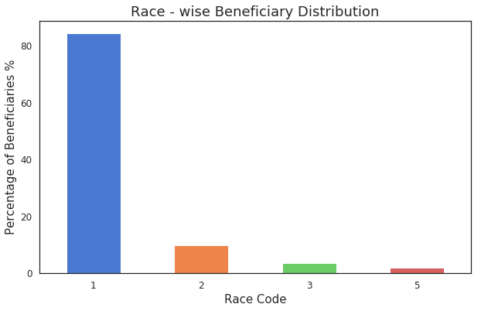
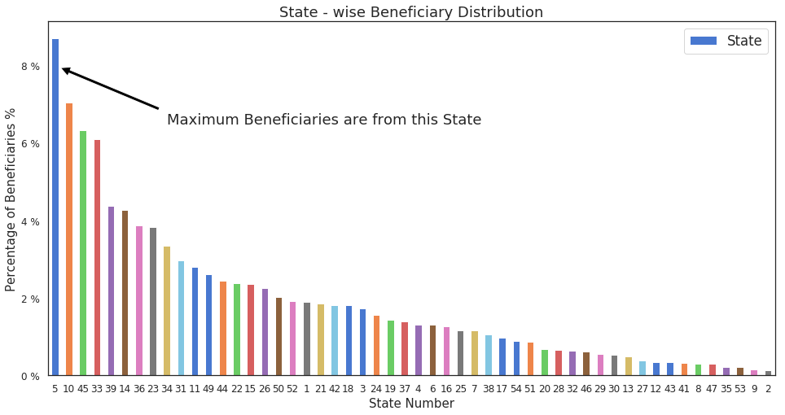
PATIENT INFORMATION (CONT..)

Slide 17
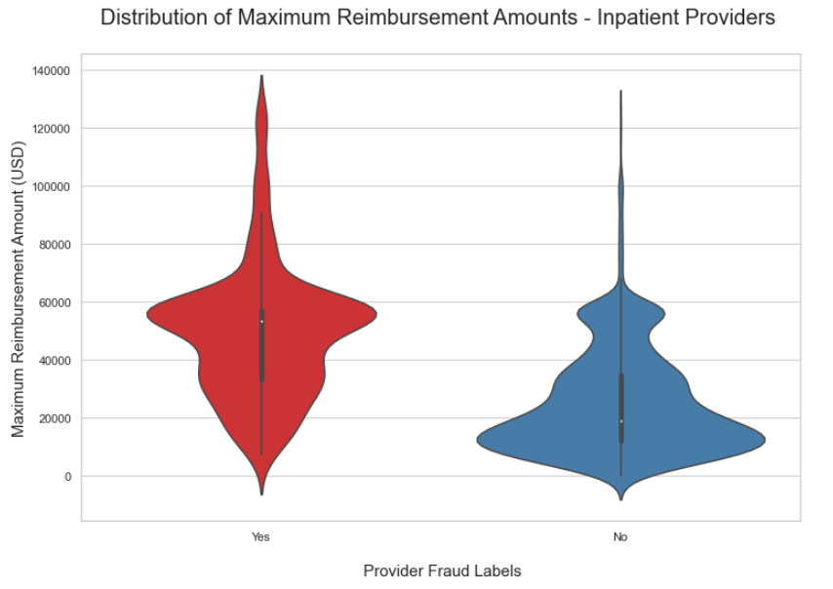
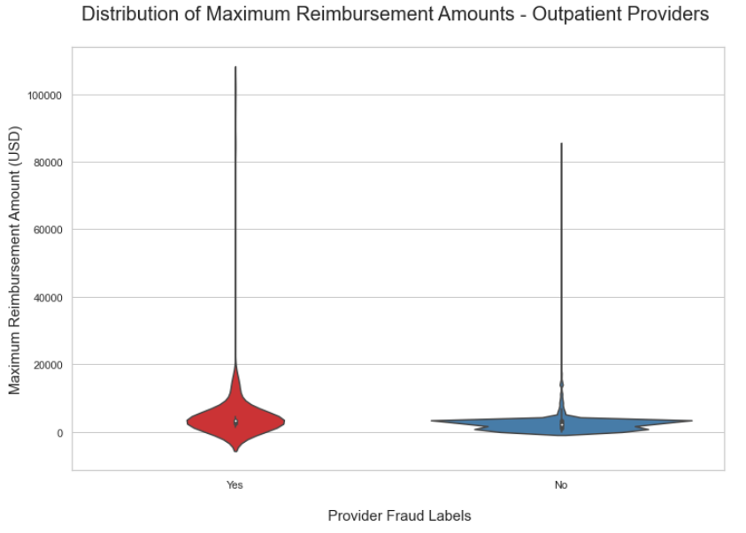
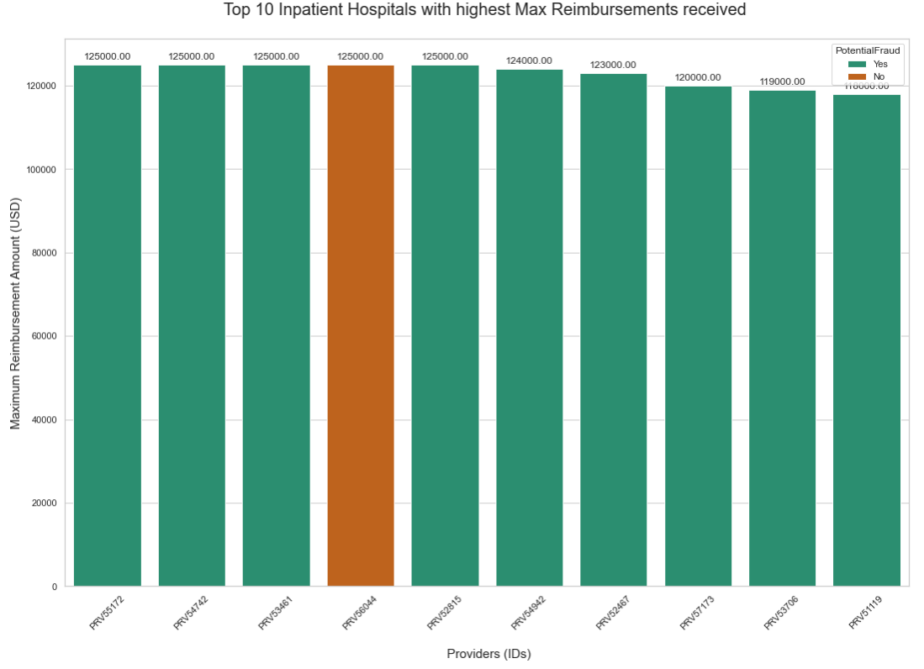
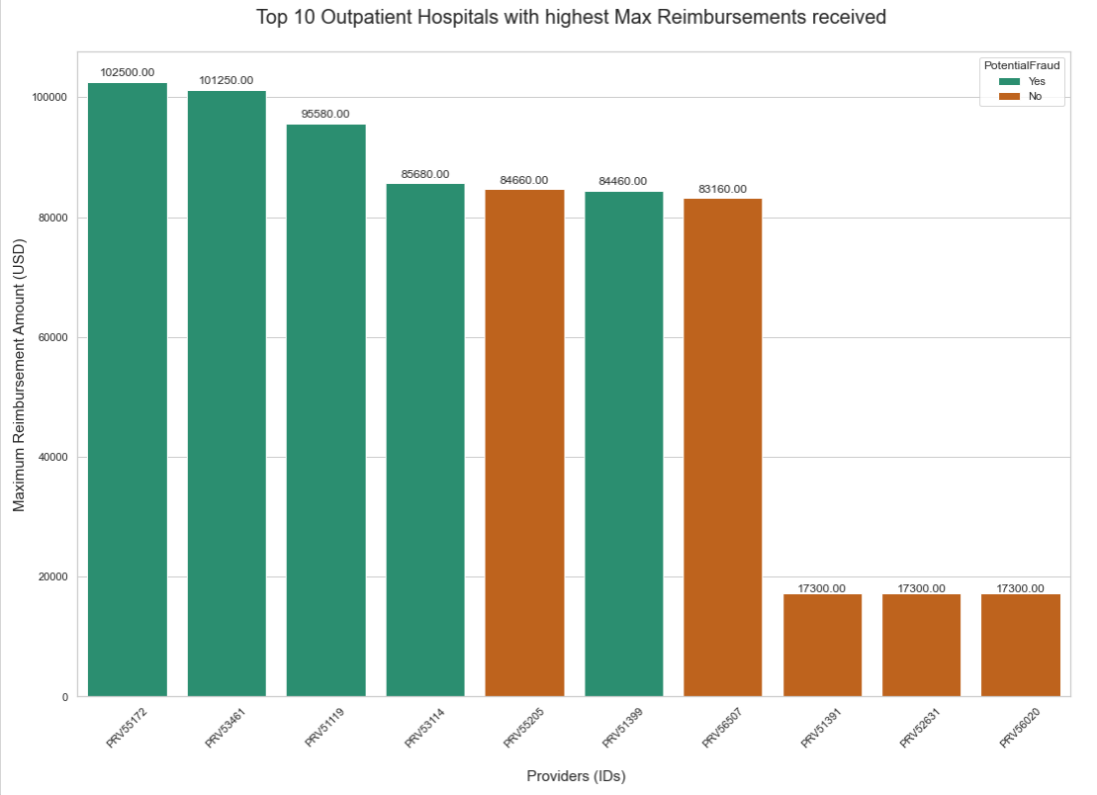
Fraud vs non-fraud provider study:

Slide 18
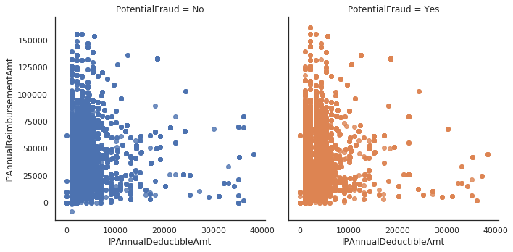
Fraud vs non-fraud provider study:

Slide 19
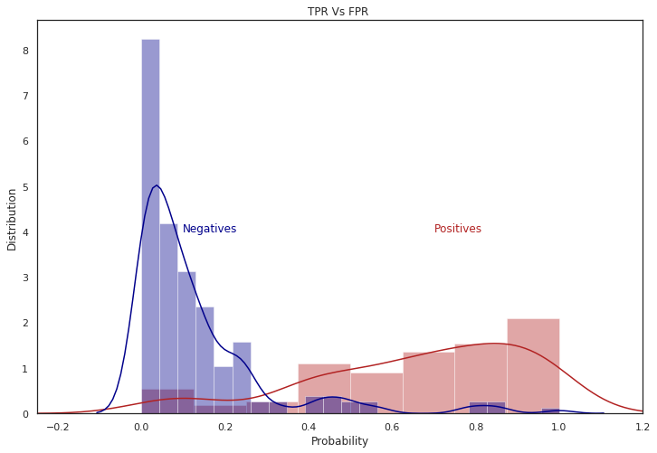
Random Forest: TPR Vs FPR

Slide 20
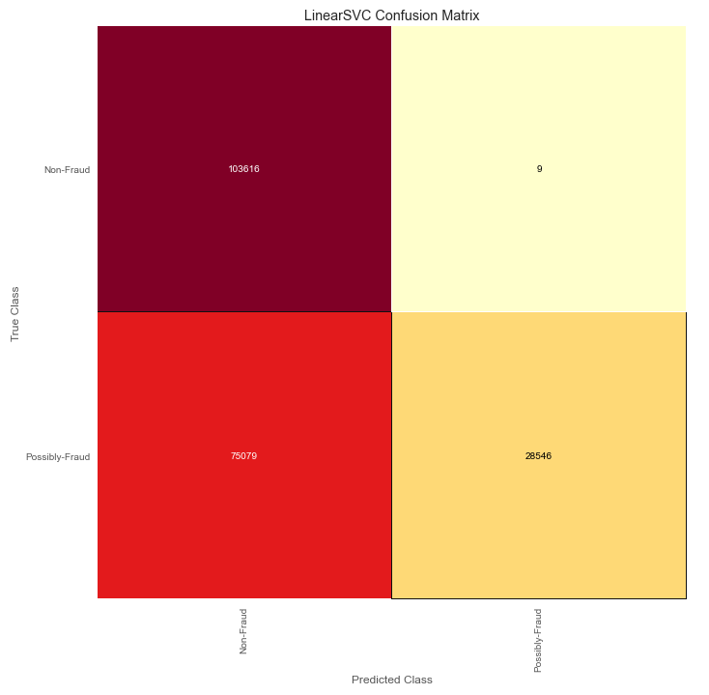
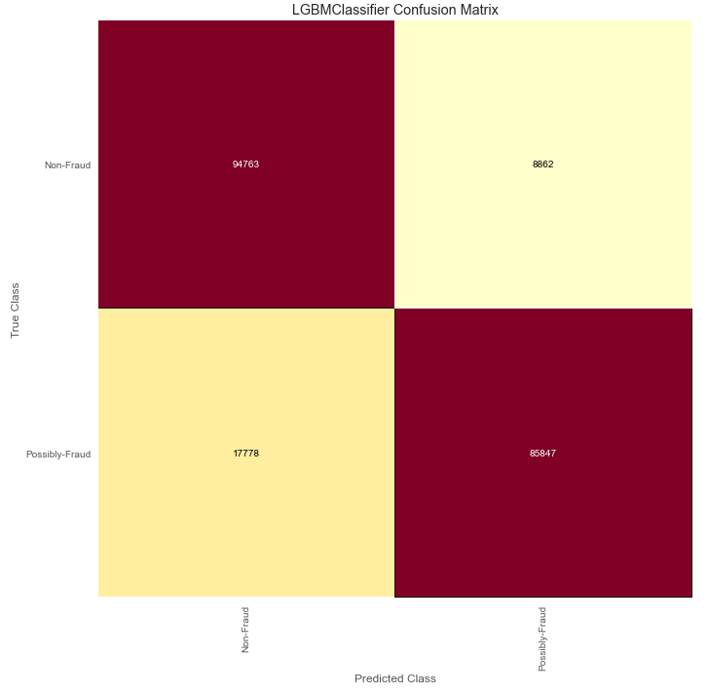
Light GBM Model (smote data)
LightGBM is a popular open-source gradient boosting framework that uses decision tree algorithms for solving classification and regression problems. It was developed by Microsoft and is designed to be efficient, fast, and scalable

Slide 21
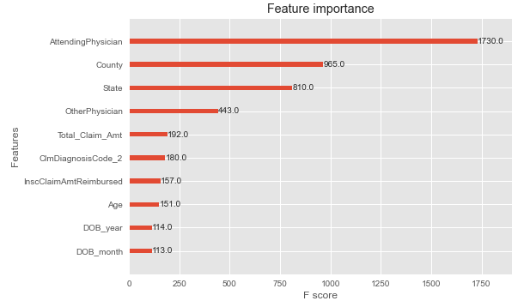
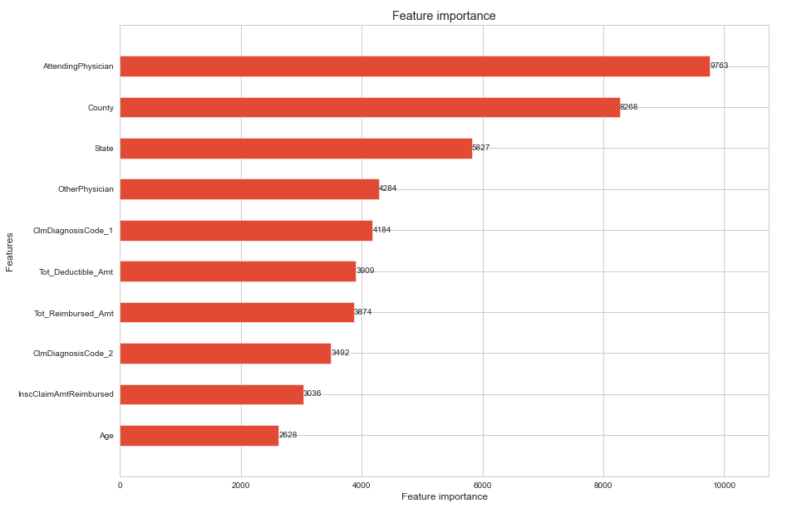
FEATURE IMPORTANCES:
XG Boost Model:
LightGBM Model:

Slide 22
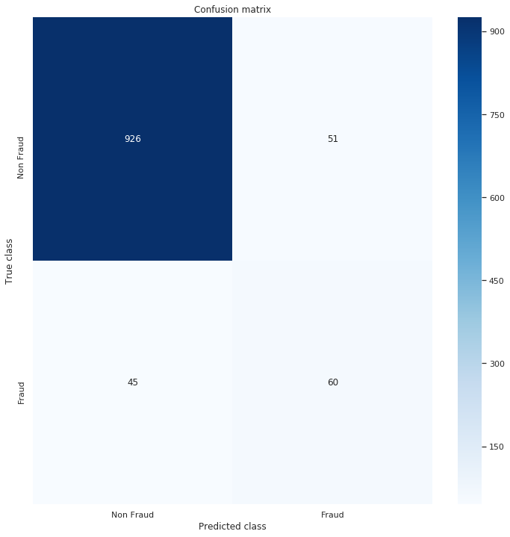
FEATURE IMPORTANCES: Confusion matrix

Slide 23
Business Recommendation and Improvement
1) Above model will help in predicting Provider fraud ,which will be helpful for insurance companies to scrutinize
claims thoroughly.
2) Further improvement in the project will help Government to take decision against fradulent health providers
and will help in ammending rules and regulations in this domain.
3) Improvement in the model will help in detecting networks of fraud Physicians,Providers and Beneficiaries.
4) This type of project will help in improving health of economy by reducing inflation caused by fraud peers and
lowering down insurance premiums which will certainly not cause health to become costly affair.

Slide 24
CONCLUSIONS:
Certain Beneficiaries having high reimbursement amounts or paying high deductibles also have more chronic conditions and could be more susceptible to fraud.
Possibly Fraud providers could be more in certain states and counties.
A patient’s age being in a certain range, and who their primary doctor is could in certain cases make them more vulnerable to fraud.
Possibly Fraud Providers | Non-Fraud Providers
High average claim reimbursement amounts. Some of these providers have the highest reimbursement amounts in the dataset. | Low average claim reimbursement amounts
High average number of patient insurance claims. | Low average number of patient insurance claims.
A narrow range of patient age. | A wider range of patient age.
A narrow range of total patient chronic condition counts. | A wider range of total patient chronic condition counts.
Outpatient – high number of diagnosis codes listed on claims | Outpatient - low number of diagnosis codes listed on claims
Future work: Duplicate claim investigation, Doctor-Hospital Network analysis, studying patterns in beneficiaries, and conducting a market basket analysis.

Slide 25
THANK YOU

